Slide 1
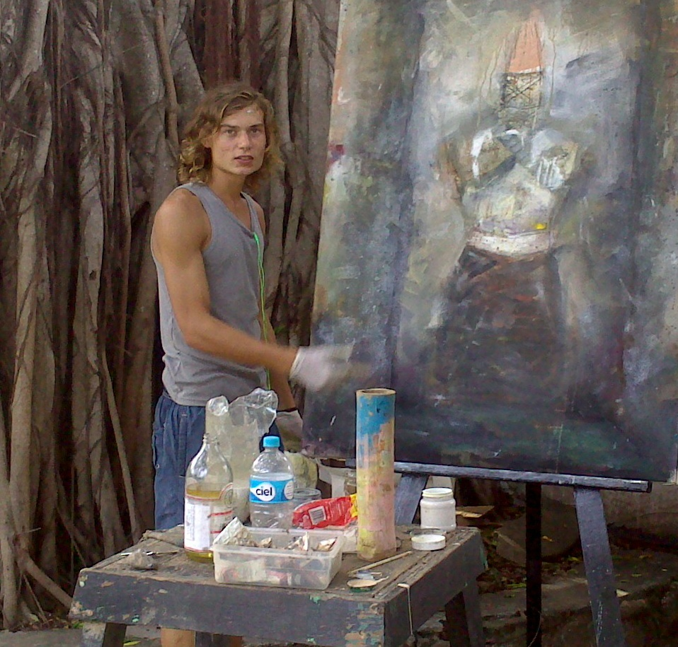

Stifled Consciousness
A series of paintings for a Mexican Government Arts Residency Scholarship
Puerto Vallarta, Mexico
October 2013 - January 2014
Exhibition at the Embassy of Mexico,
South Africa
February 5th, 2015

Slide 2
A Thank you
I would like to thank His Excellency the Ambassador of Mexico to South Africa, Mr. Héctor Valezzi, and the Embassy of Mexico in South Africa for assisting me with this project and generously hosting this Exhibition.
I would also like to thank Señora Alejandra Martínez, First Secretary to the Embassy, for her personal invaluable advice and support.
I would also like to thank the Secretaría de Relaciones Exteriores and the Dirección General de Cooperación Educativa y Cultura, and Señora Verónica de Jesús Méndez, for the residency scholarship and the opportunity to visit Mexico and for assisting in bringing these paintings back to South Africa.

Slide 3
THE STIFLED CONSCIOUSNESS:
A series by Jean Greeff
This body of work titled The Stifled Consciousness was produced during a three-month artistic residence in Puerto Vallarta, Jalisco in Mexico during 2013. The artist, who already had interest in becoming acquainted with Mexico, took in the experience of the immersion in the Mexican culture and transformed it through his art into the canvas we are presented in this exhibition.
These paintings engage with the spectator in various ways. First you perceive the use of the technique and selection of theme. Then you are welcomed into the atmosphere created by the artist and finally you get a glimpse of how the Mexican reality meddled into his work. You can perceive hints of the culture, the history, some legends and its beautiful people.
Jean reveals himself to us in a unique and very personal way through his paintings. It is almost like letting us into his particular universe. And from there it is easy for us to create our own personal realm where we can interconnect. His work makes us consider the subdued, the contained awareness that comes with the acknowledgment of the other, whom he observed and interacted with during his time spent in Mexico. So for me, this work is a testimony of his experience. And I hope this is the beginning of a long-term exchange relationship between South Africa and Mexico, for other artist on both countries to have access to the opportunity that was given to Jean.
Sara Beltran, January 2015

Slide 4
LA CONCIENCIA REPRIMIDA
Es una serie de lienzos que buscan iluminar la condición humana y cómo el arte puede reflejar la supervivencia, el desarrollo y la liberación de la espiritualidad y de la cultura, en un mundo gobernado por imperativos económicos y tecnológicos.
Cada lienzo ilustra un aspecto de estos elementos, según los veo yo -un joven sudafricano-, después de investigar y tratar de entenderlos en el contexto de la sociedad mexicana.
La serie de pinturas, vistas en conjunto, pretende dar una respuesta a mi visión personal y al viaje del espíritu como artista, en el contexto de mi experiencia e inmersión en la cultura mexicana, su historia y su dinamismo característico.
Esta serie tiene la intención también, de crear un estado de conciencia y participación en el espectador, donde la espiritualidad y la cultura, buscan enmarcar dos visiones de la sociedad que no están impulsadas ​​por la economía o la tecnología.
Para desarrollar el contenido de estas obras, "viví" mi pintura durante mi estancia en México. Esto lo hice mediante la interacción, la absorción, además de la investigación y la exploración de diversas comunidades mexicanas, sus tradiciones y culturas.
Jean Charl Greeff

Slide 5
THE STIFLED CONSCIOUSNESS
Is a series of paintings that seeks to illuminate the human condition; how art can reflect the survival, development and release of spirituality and culture in a world governed by economic and technological imperatives.
Each canvas illustrates one aspect of these elements as I see them as a young South African, after researching and trying to understand them in the context of Mexican society.
The series of paintings, viewed together, is intended as a response to my personal and spiritual journey as the artist, in the context of my experience of Mexican culture, its history and its dynamic characteristics.
The series also intends to create a state of awareness and participation in the viewer where spirituality and culture frame two visions of society that are not driven by economics or technology.
To develop the content and context of these works, I set out to "live" my painting during my stay in Mexico, through interaction, absorption, research and exploration of many different Mexican communities, traditions and cultures as practical.
Jean Charl Greeff

Slide 6
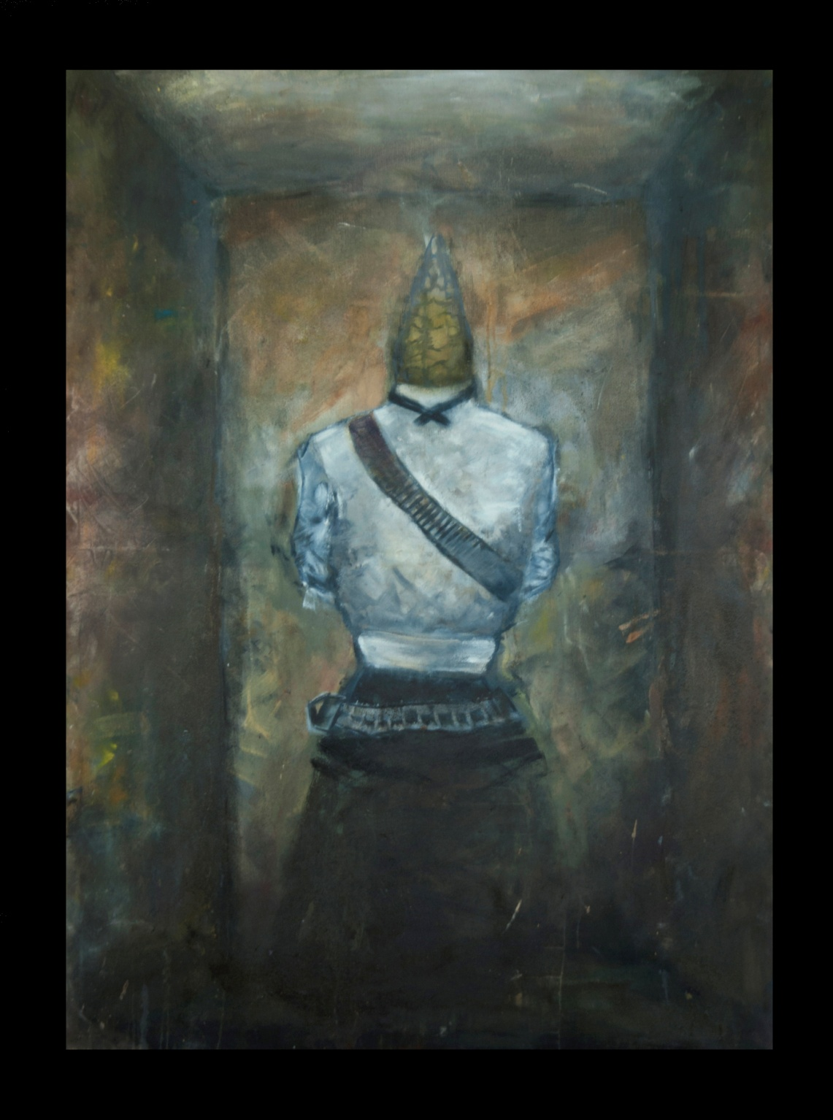
Jean Greeff Mexico 2014

Slide 7
Forgotten Feminine celebrates and honours the women of the Mexican Revolution by paying tribute to women that have endured and supported men through that struggle.
Forgotten Feminine / Feminidad Olvidada
Mix Media
100 x 150 cm

Slide 8
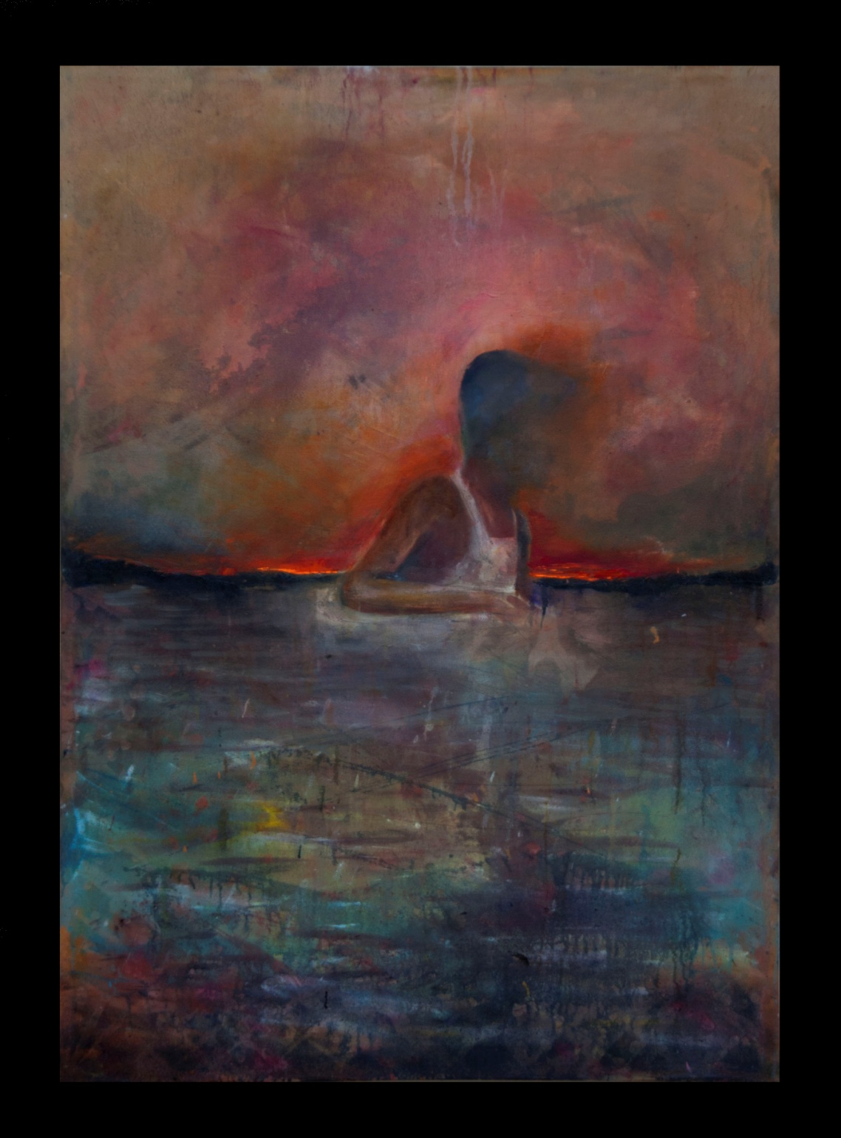
Jean Greeff Mexico 2014

Slide 9
Innocence portrays the youth of the Mexican Socio-Economy. This faceless portrait of a boy is inspired by actual events.
Innocence / Inocencia
Mix Media
100 x 150 cm

Slide 10
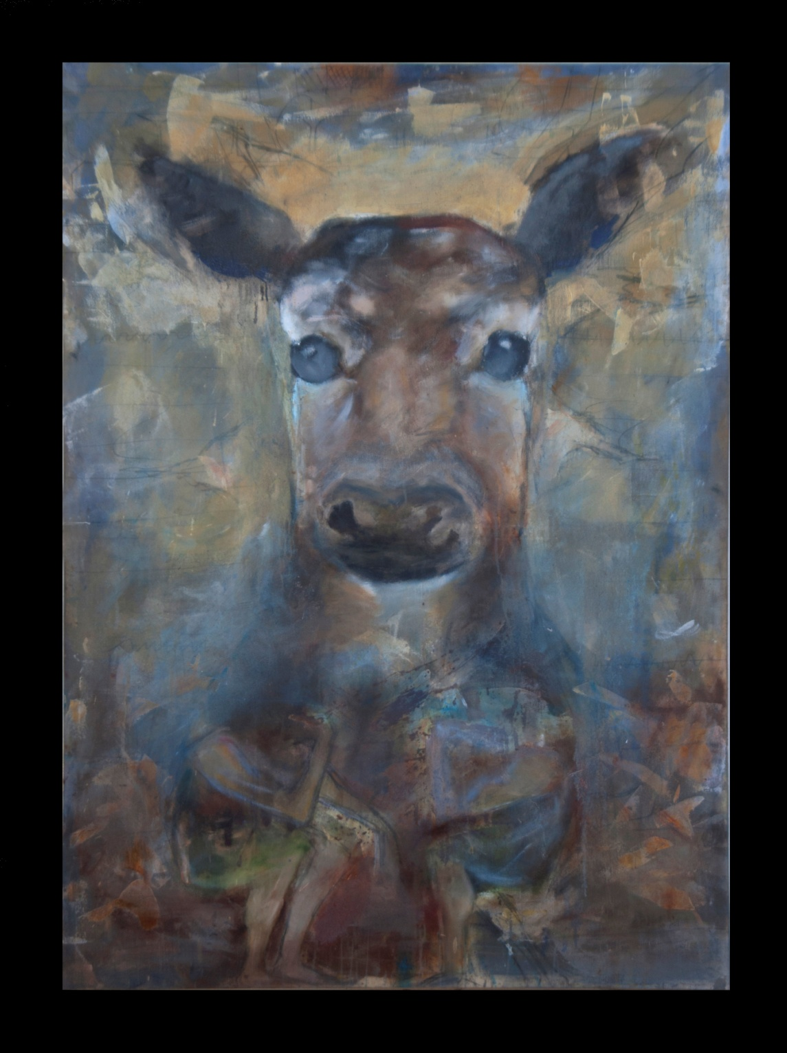
Jean Greeff Mexico 2014

Slide 11
Light is inspired by a Mexican tribal legend that derives from the Huichol tribe and speaks of a mystical blue deer.
Light / Luz
Mix Media
100 x 150 cm

Slide 12
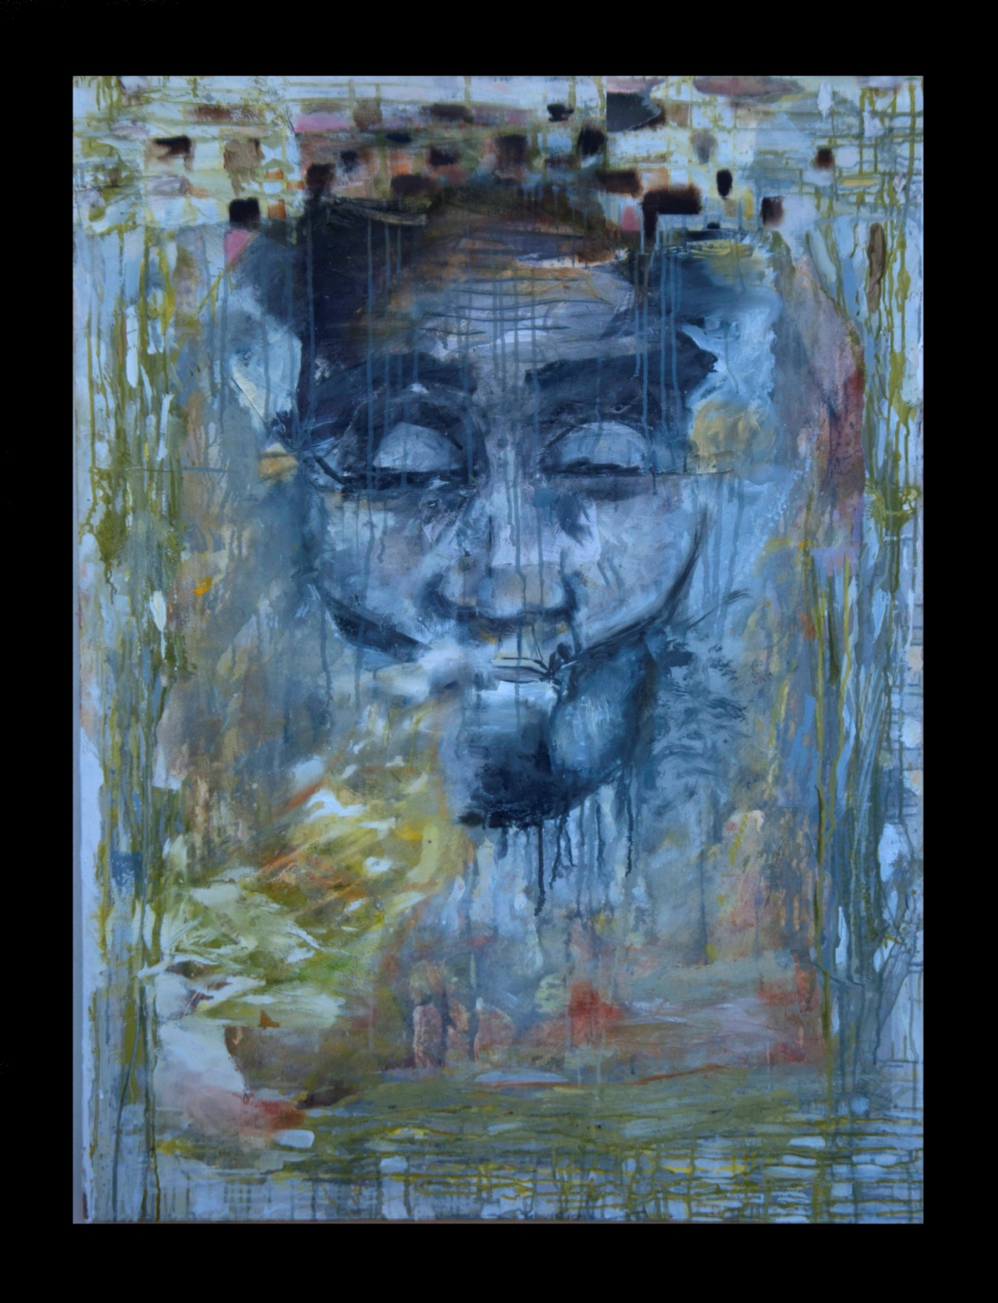
Jean Greeff Mexico 2014

Slide 13
Misunderstanding is a tribute to María Sabina, a Mazatec healer, curandera, and Shaman. She is a native of Huautla de Jiménez, in the state of Oaxaca, Mexico. She passed away in 1985 at the age of 91. She is famous for the role she played introducing the sacred mushroom ceremony velada to the world; in her last years she was exiled from her people for exposing their sacred rites to the outside world.
Misunderstanding / Malentendido Mix Media
100 x 150 cm

Slide 14
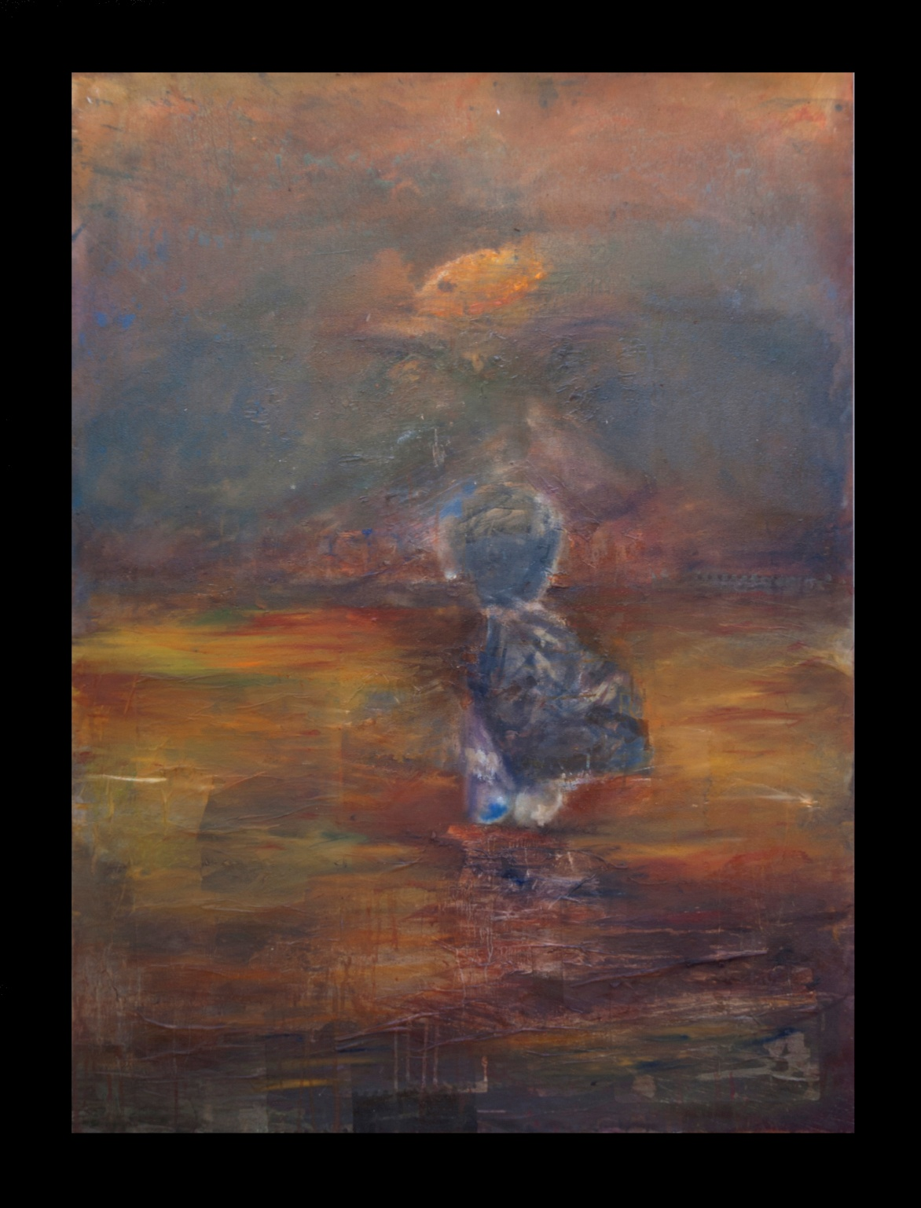
Jean Greeff Mexico 2014

Slide 15
Journey is a reflection of the inner journey I underwent as an artist, experiencing Mexico and its people. Journey also reflects on the challenges that Mexican youth experience in such a demanding world and society.
The Journey / El Viaje
Mix Media
100 x 150 cm

Slide 16
Una nota personal:
Desde hace algun tiempo había querido viajar a México para estudiar y conocer a la gente y la cultura de esta nación tan importante por su historia. Sudáfrica y México parecen compartir similitudes—desde la perspectiva histórica y moderna—. Son dos pueblos que comparten limitaciónes económicas y políticas. Pero a pesar que las dos naciones son distintas en la naturaleza de sus culturas respectivas, comparten dilemas y respuestas a temas contemporaneos.
Me gusta aprender sobre temas socio-económicos, pero me interesa más la evolucion espiritual del pueblo mexicano, su cultura, su gastronomía, sus sueños y sus aspiraciones. La cultura y arte de la Meso-América antigua y moderna, tocan emocionalmete y de una forma profunda mi alma y quisiera absorber la maravilla y la energía de la vida cultural de Mexico. Esta oportunidad de visitar y trabajar con artistas en México es algo con lo que había sonado desde hace tiempo.
Lo que quería lograr a través de este proyecto en México era reflejar la experiencia de un viaje personal. México me parece, es cuna de una gran energia, que se expande y permite la expresión creativa y el amor hacia el trabajo artísitico – esto ilumina una parte profunda dentro de mí y se ha convertido en mantra personal en mi vida diaria.

Slide 17
A Personal Note:
For a while I have wanted to travel to Mexico to study and get to know the people and culture of this historic and important nation. South Africa and Mexico seem to share many similarities – from the historical to the modern dispensations - two diverse peoples who share similar economic and political imperatives. Yet although the two nations are worlds apart in the nature of their respective cultures, their dilemmas and responses to contemporary issues are shared.
I am fascinated to learn about such socio-economic matters but also the spiritual journey of the Mexican people, their culture, cuisine, dreams and aspirations. The Culture and Art of ancient and modern Meso-America has for a longtime caused a stirring in my soul and I wish to absorb the wonder and the vibrancy of life in Mexican culture. Such an opportunity to visit and work with artists in Mexico is what I have dreamed about.
What I wished to achieve in Mexico through this project was to reflect a personal journey in my life up to that point. Mexico to me seems to cradle a strong energy, compassion and desire for creative expression and love – this illuminates a deeper context within myself and is a personal mantra in my day to day life.

Slide 18
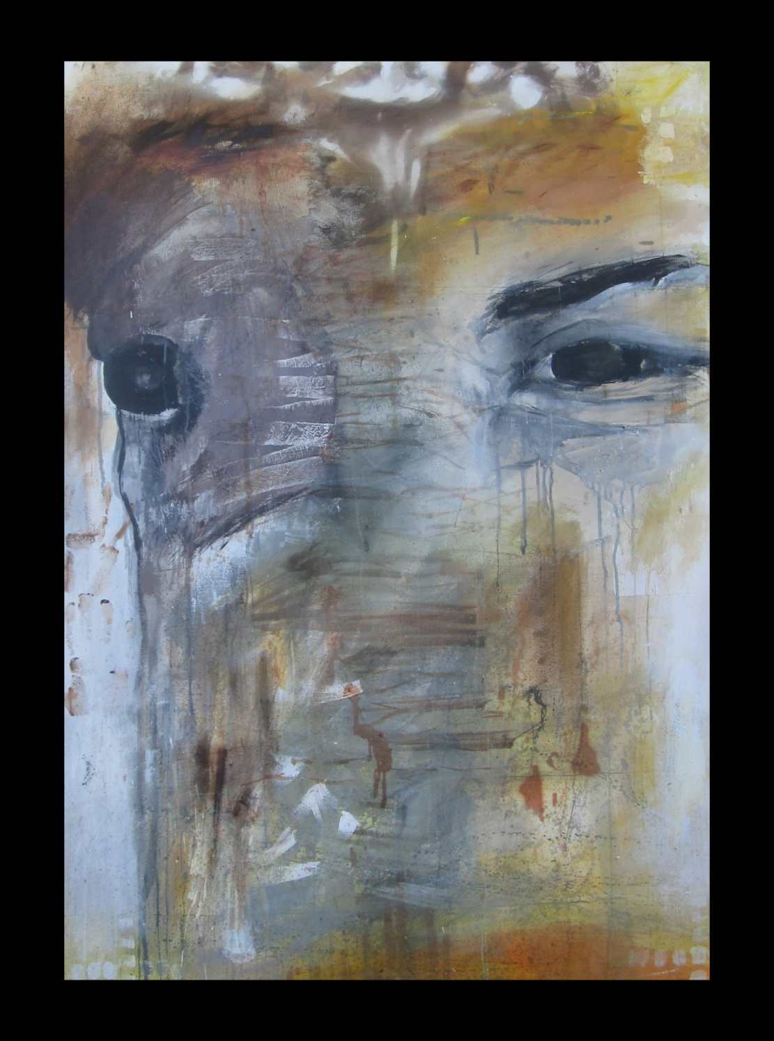
Jean Greeff Mexico 2014

Slide 19
Mexico and South Africa share many similar things - geographical features, social and economic challenges, an abundant and wondrous nature and rich wildlife.
Truth is a very spontaneous painting; this particular subject reflects my deep empathy for animals and belief that we share a soul connection with these sentient beings. I also believe that the way we humans treat animals serves as a mirror to how humanity treats its own kin.
Truth / Verdad
Mix Media
100 x 150 cm

Slide 20
Biografía
Jean Greeff nació en 1994. Completó sus estudios en la Jan van Riebeeck High School en Ciudad del Cabo , Sudáfrica. Al salir de la escuela Jean se volcó en su arte y, aunque todavía joven , ha completado varias comisiones . Sus obras están en exhibición en MM Galerías Ciudad del Cabo, Sudáfrica y en la Diaz Galería Mara en Puerto Vallarta en México un vibrante colectivo liderado por la destacada artista vallartense, Mara Díaz.
En 2013 Jean Greeff fue galardonado con una Beca de Artes del Gobierno de México para visitar México, en una residencia de artes de tres meses en Puerto Vallarta, Jalisco. Durante este tiempo creó una serie de lienzos inspirados por su reacción a México y su cultura y su gente. Eligió como tema para esta serie la exploración de la espiritualidad y cómo se puede sobrevivir en un mundo dominado por imperativos socio-económicos y la tituló La Conciencia Reprimida.
Jean es el primer sudafricano en recibir esta Beca del Gobierno Mexicano.
Los intereses personales particulares de Jean se pueden ver reflejados en sus obras de arte, al igual que aspectos espirituales de las culturas del mundo y elementos de la naturaleza. En sus obras, se esfuerza por manifestar la 'metafísica' y le gusta experimentar con los colores y las texturas abstractas. También está interesado en "objetos naturales" como se puede ver en su serie de las cabezas y los objetos que se encuentra en sus viajes.

Slide 21
Biography
Jean Greeff was born in 1994 Cape Town, South Africa. Jean’s works are on display at MM Galleries in Cape Town South Africa and in the Mara Diaz Gallery in Puerto Vallarta, Mexico - a vibrant young artist collective founded by a leading young Vallartan painter, Mara Diaz.
In 2013 Jean Greeff was awarded a Mexican Government Arts Scholarship to visit Mexico, for a three-month arts residency in Puerto Vallarta, to create a series of canvasses inspired by his reaction to Mexico, its culture and people, on his chosen subject: “Stifled Consciousness”.
He is the first South African to be awarded this scholarship. Jean’s particular personal interests can be seen reflected in his artworks – mysticism, the spiritual aspects of world cultures and elements of nature. In his work he strives to manifest the ‘Metaphysical’ and likes to experiment with abstract colours and textures. Jean is currently studying with Gila Band, a leading South African artist and is also under the tutelage of Gail Catlin, one of South Africa’s most renowned and internationally exhibited conceptual contemporary artists.

Slide 22
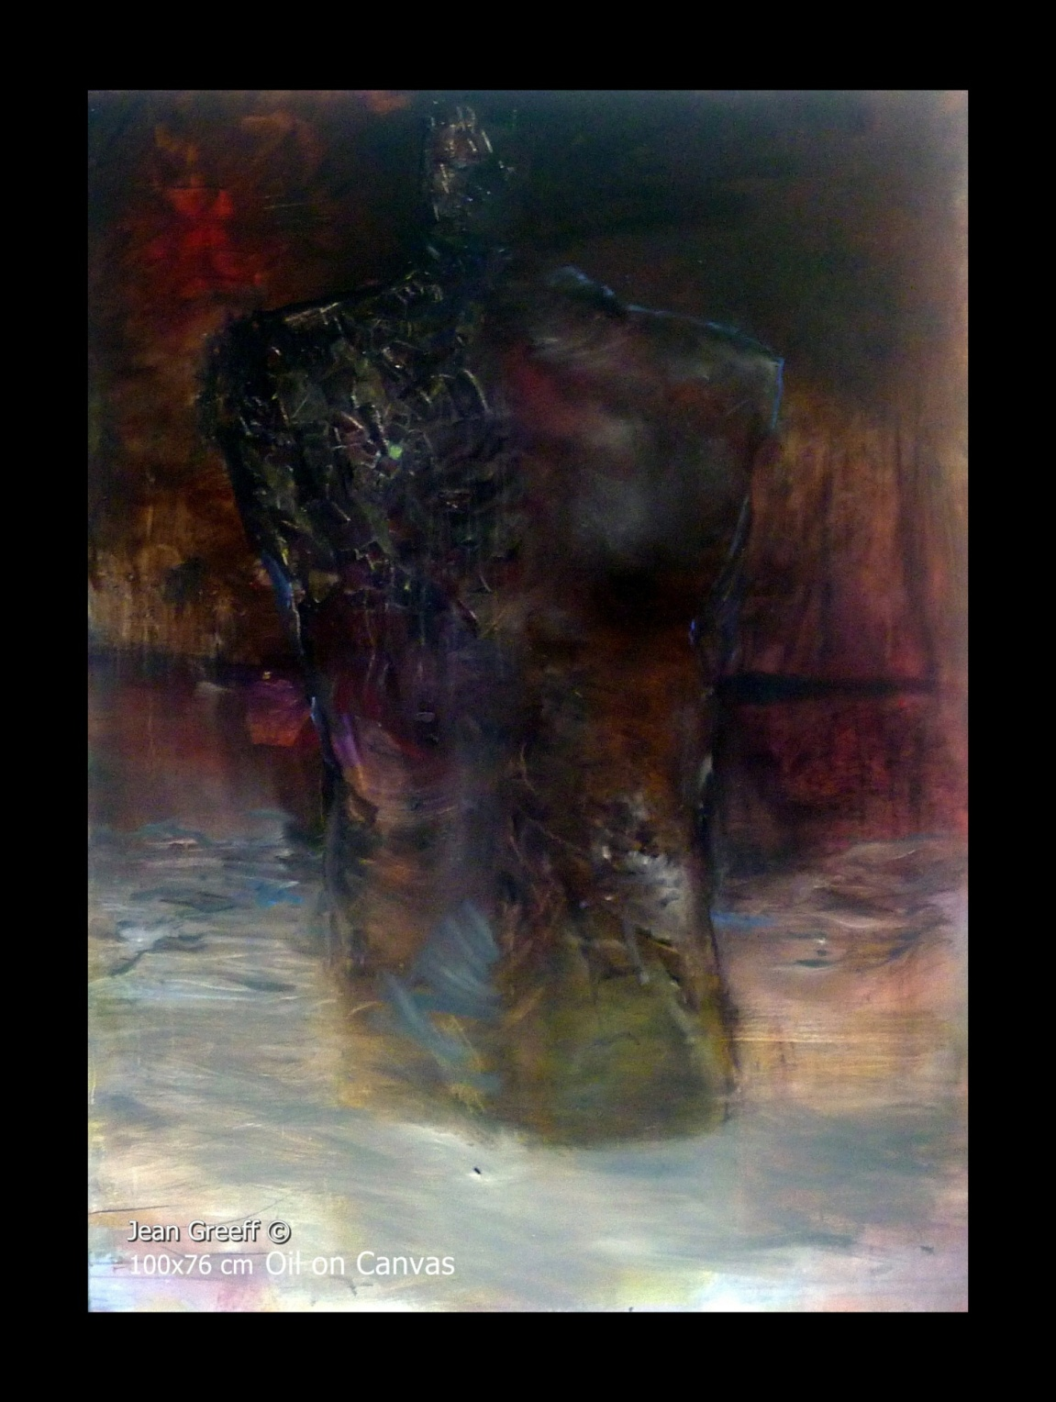

Slide 23
Stifled Waters (not on display) is a study painting for the series The Stifled Consciousness. This painting was created in South Africa under the guidance of Gail Catlin, one of South Africa's most renowned and internationally exhibited contemporary artists.
Stifled Waters
Oil on Canvas
100 x 76 cm

Slide 24
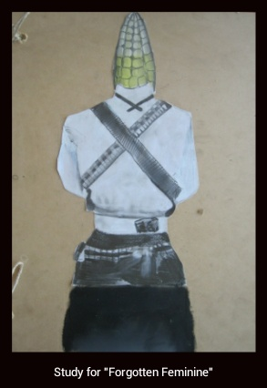
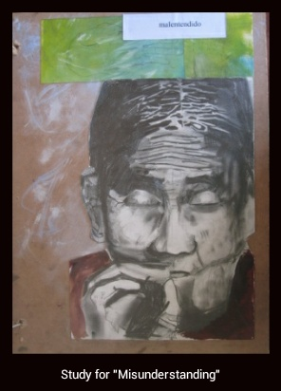
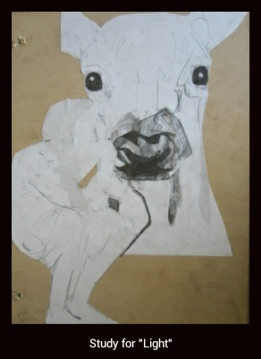
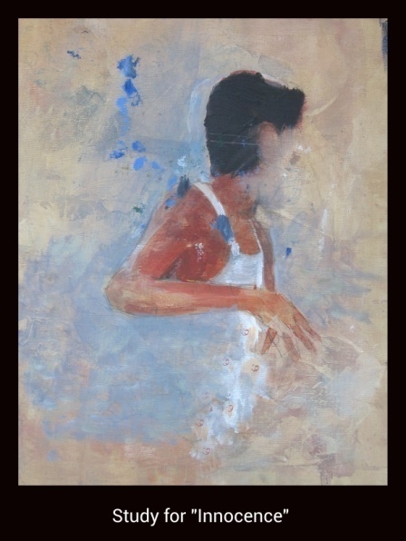
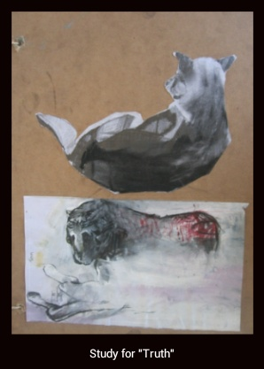
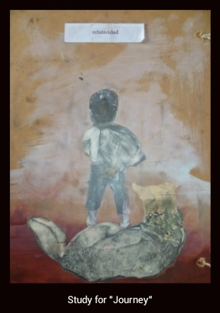
Preliminary Works

Slide 25

Estoy muy agradecido por el generoso apoyo brindado
a través de:
LA EMBAJADA DE MÉXICO EN SUDÁFICA
EL GOBIERNO MUNICIPAL DE PUERTO VALLARTA
EL INSTITUTO VALLARTENTESE DE CULTURA
Profr. Sergio Moncada Cooley
Maestro de Pintura y Escultura
Lic :Sergio José Zepeda Moreno
Director del Instituto
LA SECRETARÍA DE RELACIONES EXTERIORES
LA DIRECCIÓN GENERAL DE COOPERACIÓN EDUCATIVA Y CULTURA

